Slide 1
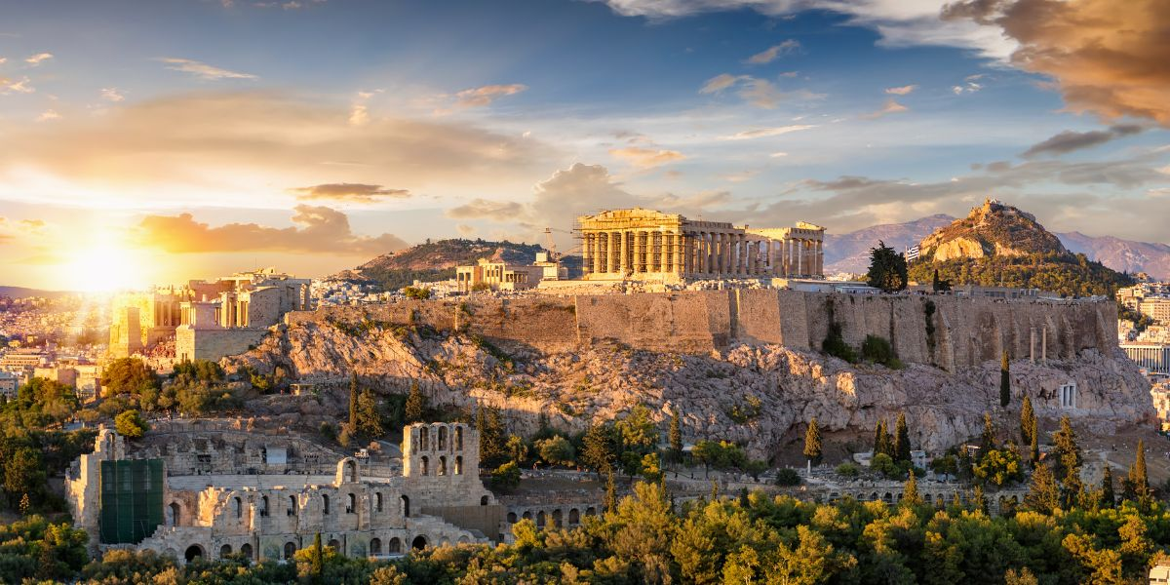
Historic Places in Greece
Αn original presentation prepared by the HELLENIC CULTURE CENTRE VIP Project EU 5

Slide 2
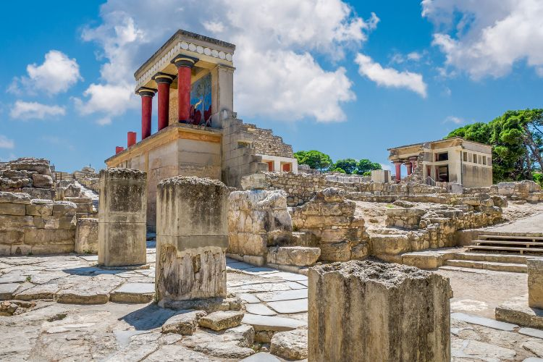
Knossos Palace, Crete
Knossos is central to Minoan civilization and the myth of the labyrinth and Minotaur.
The palace’s complex architecture and advanced features, such as an early form of plumbing, reflect the sophistication of Minoan society.
Connected to Santorini, as Thera belonged to the Minoan Civilization

Slide 3
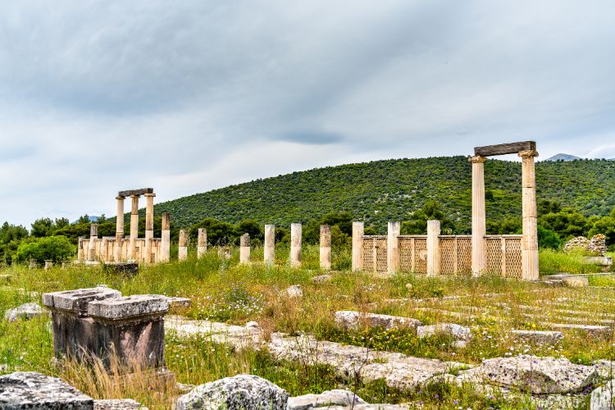
The Sanctuary of Asklepios at Epidaurus
The sanctuary was an ancient healing center, famed for its dream cures.
Patients would sleep in the abaton, or dormitory, hoping to receive a dream visitation by the god, which priests would interpret as prescriptions for healing.

Slide 4
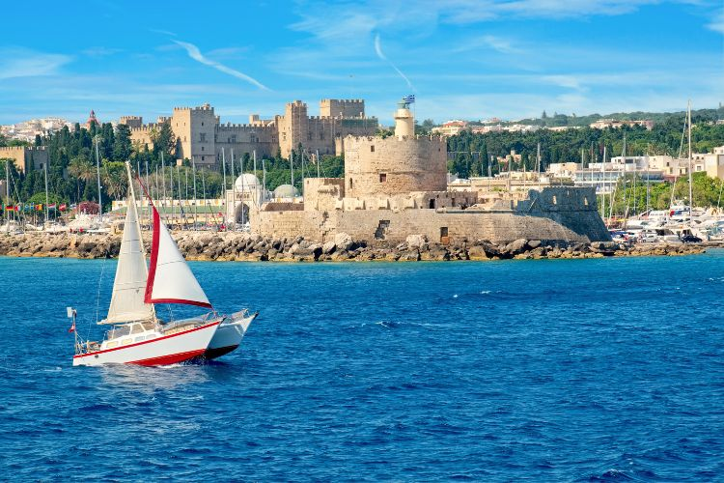
The Medieval City of Rhodes
The city’s architecture is a tapestry of historical periods, with influences from the Knights Hospitaller, the Ottomans, and the Italians.
The Street of the Knights and the Palace of the Grand Master are highlights.

Slide 5
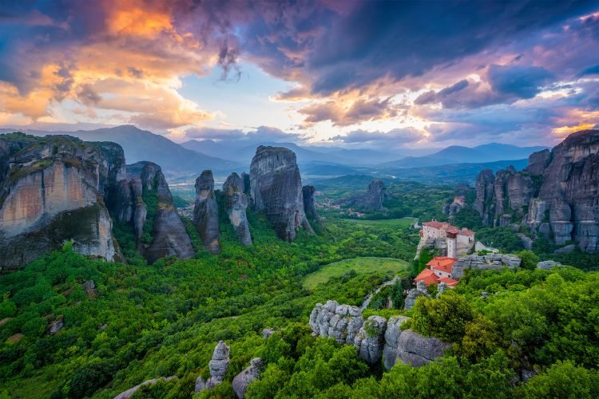
The Meteora Monasteries
Meteora, meaning “suspended in air,” comprises six monasteries that are accessible to the public.
The monasteries were established by hermit monks in the 14th century as a refuge from Turkish invaders.
They are of unique positioning and construction

Slide 6
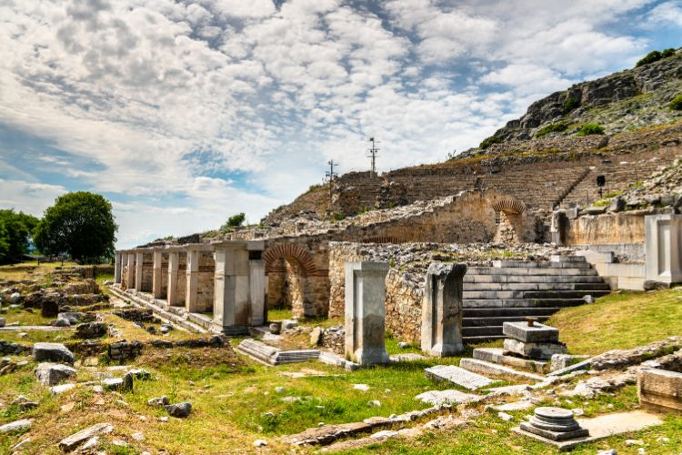
The Ancient City of Philippi
Philippi, founded in 356 BC by Philip II of Macedon, played a significant role in Hellenistic, Roman, and early Christian history.
It is renowned for the Battle of Philippi in 42 BC, which marked the beginning of the end for the Roman Republic.
The site is also significant for Christians, as it is where Apostle Paul established one of the first European Christian communities.

