Slide 1
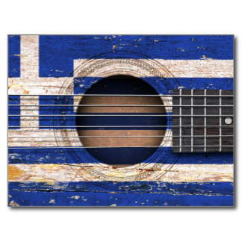
ART MUSIC FESTIVALS Αn original presentation prepared by the HELLENIC CULTURE CENTRE VIP Project EU 7

Slide 2
.
Modern Music
Art and music in Greece have a long history dating from the Antiquity
Music played an important part in the ancient Greek’s everyday life.
Music had got more ecclesiatical character in the Byzantine Empire.
Notes:
Modern music is a significant aspect of Hellenic Culture in today world. Art and music
in Greece have a long history dating from the Antiquity, when music was inseparable and
played an important part in the ancient Greek’s everyday life. Music had got more
ecclesiatical character in the Byzantine Empire.

Slide 3
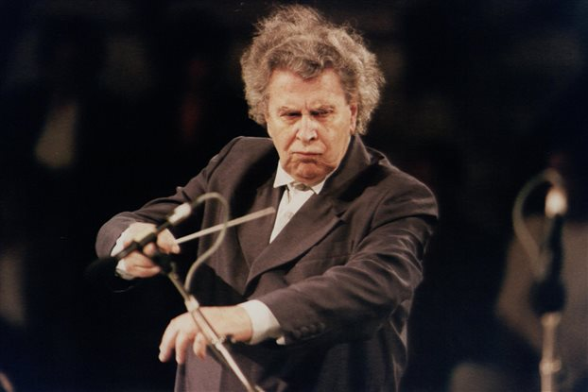
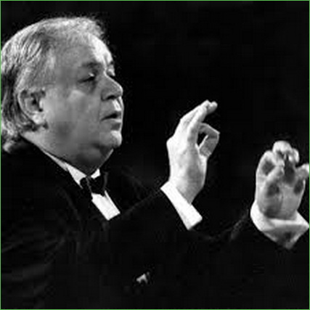
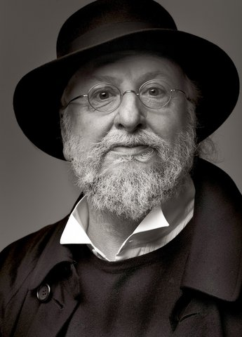
Main modern composers
Mikis Theodorakis
Manos Hatzidakis
Dionysis Savvopoulos
Notes:
Michael "Mikis"Theodorakis (born 29 July 1925) is a songwriter and composer who has written over 1000 songs. He was gained popularity after
created music for the films Zorba the Greek(1964) , Z (1969) and Serpico(1973). In today world he is best-known composers.
Manos Hatzidakis is also very famous in Greece. In 1960 he received an Academy Award for Best Original Song” for his song ,,Never on Sunday”
As well popular music composer is Dionysis Savvopoulos. He mixed American musicians like Bob Dylan or
Frank Zappa with Macedonian Folk Music.

Slide 4
Greek Folk Music

Slide 5
Greek Folk Music
Greek Folk Music traditions coming from the time of ancient Greek poetry and music
Musical instruments which is use in folk songs are the lira, laouto (lute) tambouras & gaida (bagpipe), zoumas (shawm), daouli (drum), dachares (tambourine), ziyia (paired groups), violi (violin)
Today, during the celebrations and festivals Greek people like listen the folk songs

Slide 6
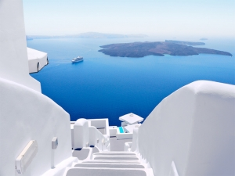
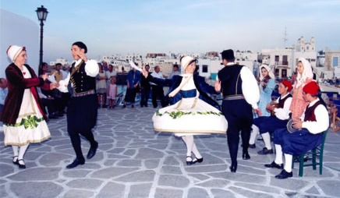
Nisiotika
Folk music of the islands
Nisiotika means ‘’of the islands’’
Notes:
Nisiotika has got connection with folk tradition. It is popular in the islands of
the central of Aegean Sea-the complexes of Cyclades, the Dodecanase and the Sporades. The
songs of this type of music are light, with a gentle rhythm without dramatic elements.
Nisiotika songs weren't popular during the 50s and 60s. In 70s a lot of singers start to sing
Nisiotika songs. The one of the main sigers Nisiotika was Mariza Koch. She represented
Greece at the Eurovision Song Contest in 1976 with the song Panayia Mou,panaia mou ( My
Holy Mother, my Holy Mother). On 14 March 2010, Alpha TV ranked Koch the 29th topcertified
female artist in the nation's phonographic era. During the 1990s and 2000s , artists
for example: Yiannis Parios, Stella Konitopoulou and the Mythos Band helped this music gain
occasional mainstream popularity.

Slide 7
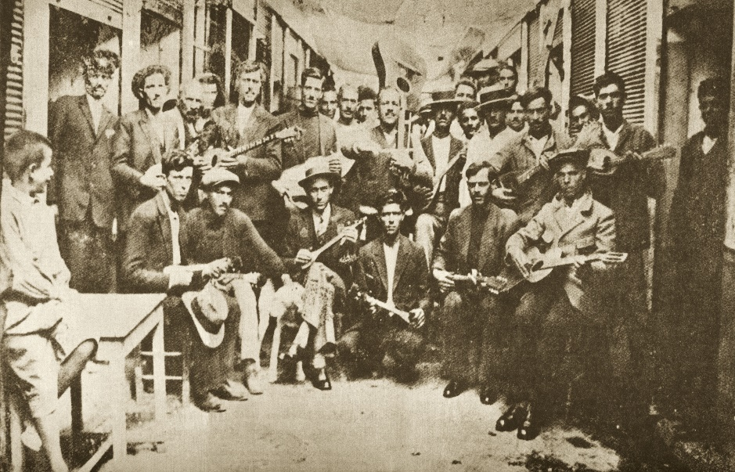
Rebetiko
Popular type of modern Greek music is Rebetiko
Borned at 1960s it was created by refugees coming from Asia Minor
Played in the nightclubs of Athens
Based on traditionall Greek or Anatolian dance rhythms
Notes:
Popular type of modern Greek music is Rebetiko which is borned at 1960s. It was
created by some of the two million refugees coming from Asia Minor. This type of music
was started to be played in the nightclubs of Athens where it became very popular. Most
rebetiko songs are based on traditionall Greek or Anatolian dance rhythms. Most common
are: Syrtos, Zeibekiko, Sirtaki, Hasapiko, Kamilierikos. The most famous players and singers
of this type of music are Vassilis Tsitsansis, Marika Ninou, Sotiria Bellou.

