Slide 1
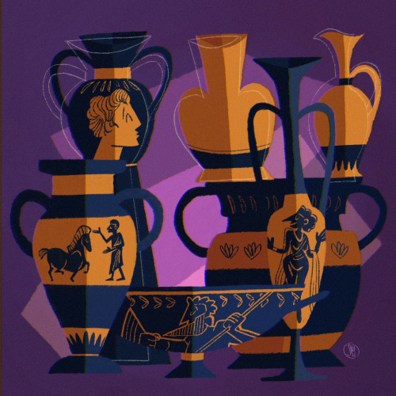
GREEK CRAFTS POTTERY Αn original presentation prepared by the HELLENIC CULTURE CENTRE VIP Project EU 9
Hellenic Culture Centre
www.hcc.edu.gr

Slide 2
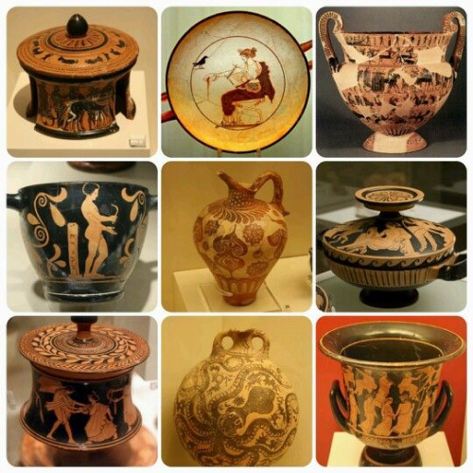
THE IMPORTANCE OF POTTERY
Large amounts of pottery have survived from ancient Greece
Source of information about many aspects of Greek life
Paintings and structures did not survive as well as ancient Greek pottery
Notes:
As with most ancient civilizations, large amounts of pottery have survived from ancient Greece. Pottery is one of the most durable materials and even when broken, the pieces of a pot can usually be put together again. This means that pottery is one of the most important sources of evidence for ancient Greece, whether for contacts within the Greek world, artistic influences from other cultures or for dating archaeological sites. Greek pottery provides information about many aspects of Greek life, cultural beliefs and practices.
What survived is often not high art, but pottery fragments, with no real value. Indeed, really valuable containers tended to be made of bronze, silver or gold, however, little of this survived because the metal was reused.

Slide 3
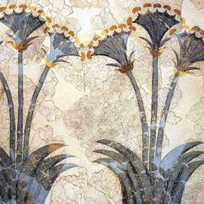
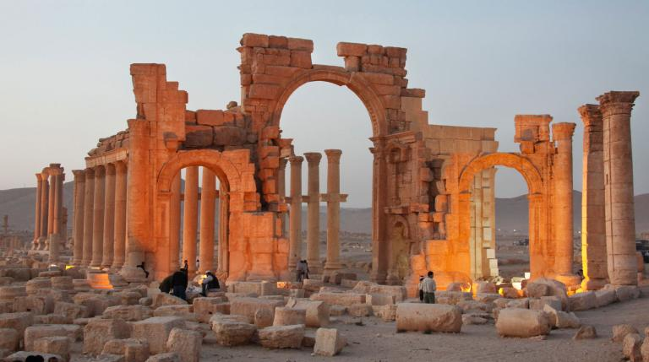
Greek painters worked mainly on wooden panels, which deteriorated over time
Metal was melted and reused during the Middle Age
Greek buildings had been destroyed, pillaged or looted for building materials
Notes:
Greek pottery became a valuable tool to study Greek history because Greek paintings and structures did not survive so well as ancient Greek pottery.
Greek painters worked mainly on wooden panels, which deteriorated over time.
Furthermore, the great bulk of Greek marble statuary was burned during the Middle Age in order to produce lime. Likewise, the shortage of metal during the Middle Age led to the majority of Greek bronze statues being melted down. Those statues which had survived did so primarily because they had been buried and forgotten, or lost into the sea.
The great majority of Greek buildings have not survived to this day: either they had been pillaged in war, had been looted for building materials or had been destroyed in Greece’s many earthquakes. Only a handful of temples, such as the Parthenon and the Temple of Hephaestus in Athens, have been spared.

Slide 4
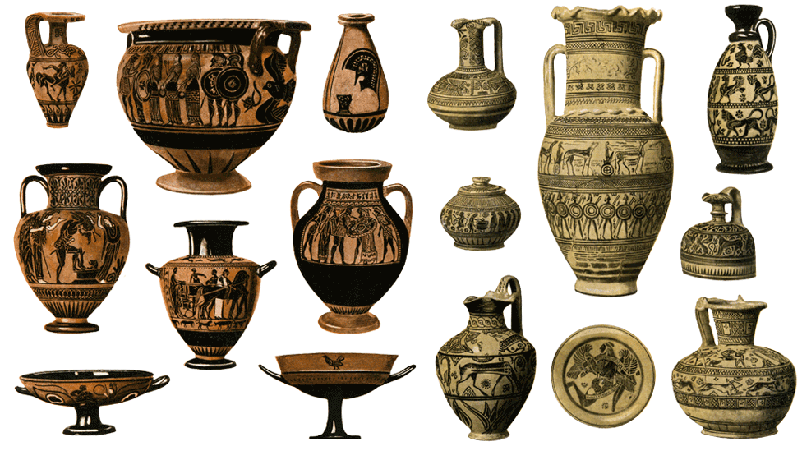
SHAPES & SIZES
Athenian pottery is the most famous type of ancient Greek pottery
Vases were used in every aspect of daily life
The shape and size of the pot are a guide to its use
Notes:
Different city states produced different styles and types of pottery. In the seventh century BC, Corinth was the leading producer and exporter of pottery, but was overtaken by Athens in the sixth century BC. Athenian pottery is the most famous type of ancient Greek pottery and was much sought after by collectors in the eighteenth and nineteenth centuries. Most of the Athenian pots in the Museum come from tombs in southern Italy and modern Tuscany - Athenian pots were extremely popular with the Etruscans.
Vases were mostly functional, made to be used not just admired. They were used in every aspect of daily life: for storage, carrying, mixing, serving, drinking and as cosmetics and perfumes containers.
The shape and size of the pot offered a common sense guide to its use, with the larger pots used to carry and store more common liquids needed in large quantities, and smaller vessels to hold rarer or more costly substances used in smaller quantities. Narrow necked pots held liquids to be poured in a slow stream, and wide neck for mixing and more rapid pouring. Some pots were also made specifically to be buried in tombs and graves.

Slide 5
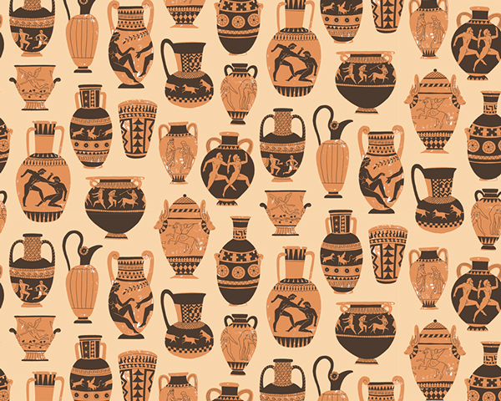
Many of the forms remained relatively constant
Pots were decorated with scenes from daily life
Sometimes these scenes reflected what the pot was used for
Notes:
Although Greek pottery provides us with a wide range of shapes from cups to plates to massive amphorae, many of the forms remained relatively constant over centuries. This is primarily because Greek potters were producing wares for practical use and once the optimum practical shape had evolved, it was copied and maintained. However, despite this restriction in form, the Greek potters and painters could express their versatility in the decoration of the vase.
Indeed, ancient Greek pots were often beautifully decorated with scenes from daily life. Sometimes these scenes reflected what the pot was used for. For example make up containers often had scenes of women holding mirrors.

Slide 6
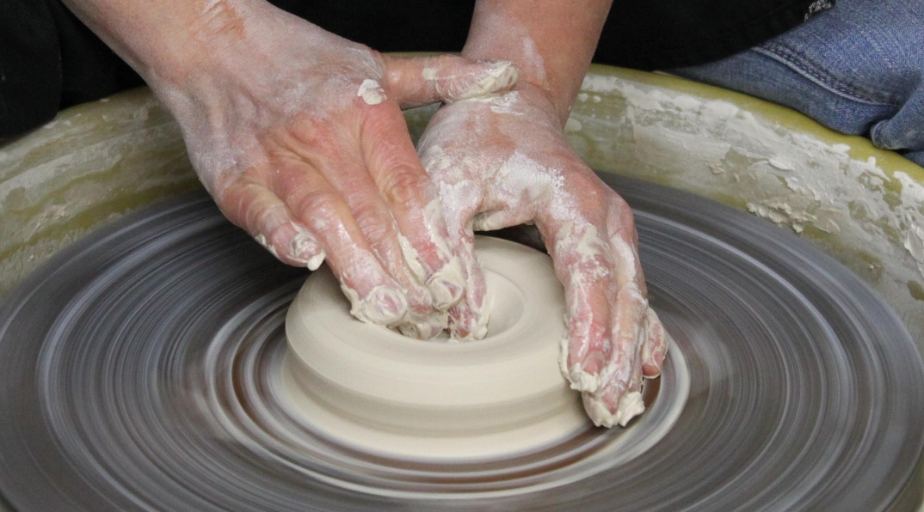
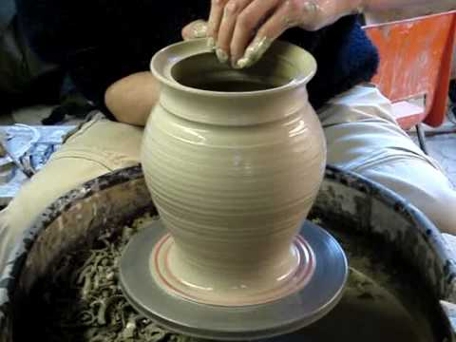
MATERIALS & PRODUCTION
The clay
Inexpensive
Readily available
Easily worked
Strong and waterproof
Ideal material for containers of all sorts
Notes:
The clay (keramos) to produce pottery (kerameiki) was readily available throughout Greece, although the finest was Attic clay, with its high iron content giving an orange-red colour with a slight sheen when fired and the ? of Corinth. Clay was generally prepared and refined in settling tanks so that different consistencies of material could be achieved depending on the vessel types to be made with it. Clay is inexpensive and readily available; it is easily worked and can be shaped as desired; once fired it is quite strong and waterproof; it makes an ideal material for containers of all sorts.

Slide 7
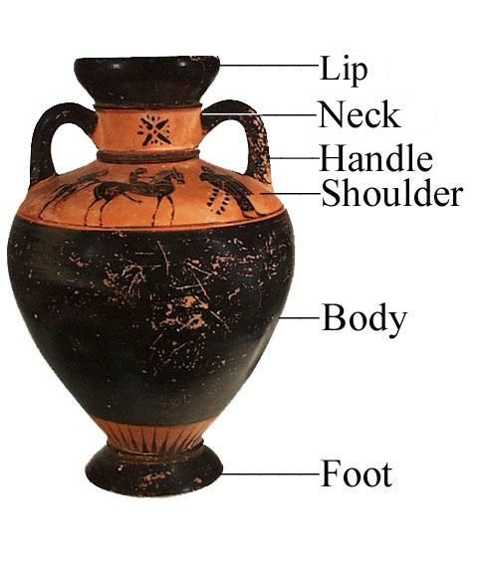
WORKING WITH CLAY
The clay is placed on a wheel, the potter forms it into the desired shapes
Large pots are made in sections: foot, lower and upper body, neck, handles
Sections are glued together with a thin layer of clay
The piece is then put back on the wheel to smooth it
Notes:
Greek pottery was invariably made on the potter’s wheel and usually made in separate horizontal sections: the foot, the lower and upper body, the neck, and finally the handles, if necessary. These sections were then joined together with a clay ‘slip’ after drying and it is possible in many cases to see the prints of the potter impressed on the inside of the vessel. The piece was then put back on the wheel to smooth the join marks and add the final shaping. Therefore, all vases were unique and the small variations in dimensions reveal that the use of simple tools and not cut-out templates was the norm.

