Slide 1
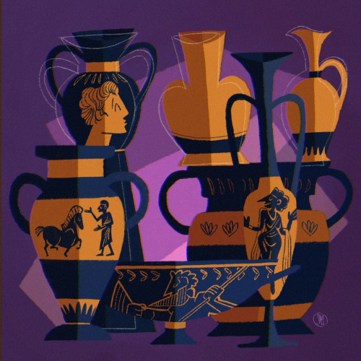
GREEK CRAFTS POTTERY Αn original presentation prepared by the HELLENIC CULTURE CENTRE VIP Project EU 10
Hellenic Culture Centre
www.hcc.edu.gr

Slide 2
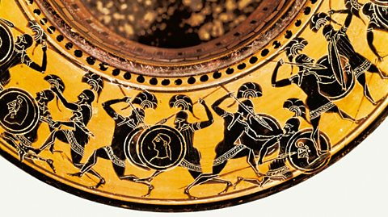
The pot is decorated depending on the style in vogue at the time
The finished pot is put in the kiln and fired at a temperature of around 960 °C
The entire object is then fired in 3 stages
Notes:
Next, the pot was decorated. This process depended on the decorative style in vogue at the time, but popular methods included painting the whole or parts of the vase with a thin black adhesive paint which was added with a brush, the marks of which remain visible in many cases. This black paint was a mix of alkali potash or soda, clay with silicon content, and black ferrous oxide of iron. The paint was affixed to the pot by using a fixative of urine or vinegar which burned away in the heat of the kiln, binding the paint to the clay. Another technique, used more rarely, was to cover the vessel with a white clay paint. Alternatively, only lines or figures were added in black using a thicker version of the black paint mentioned above and applied with a stiff brush or feather; in consequence, a slight relief effect was achieved. Minor details were often added with a thinned black paint giving a yellow-brown colour, a white pipe-clay, and a dark red of ochre and manganese. The latter two colours tended to flake off over time.
The finished pot was then ready to be put in the kiln and fired at a temperature of around 960 °C, which is relatively low and explains the ‘softness’ of Greek pottery (in comparison to, for example, Chinese porcelain). Pots were fired several times (in the same kiln) in order to achieve the required finish and colouring. First, the pot was fired in an oxidising fire where good ventilation to the kiln ensured that the orange/red of the clay came to the fore. Then the pot was re-fired in a kiln starved of oxygen (reduction process) by adding water or damp wood inside the kiln. This ensured that the painted colours, particularly the black, darkened in colour. A third firing, again with good ventilation, re-reddened the clay of the pot whilst the painted areas, now protected by a thin wash, kept their original colouring. This complicated process obviously required excellent timing from the potter so as not to spoil the vase with unseemly discolouring.

Slide 3
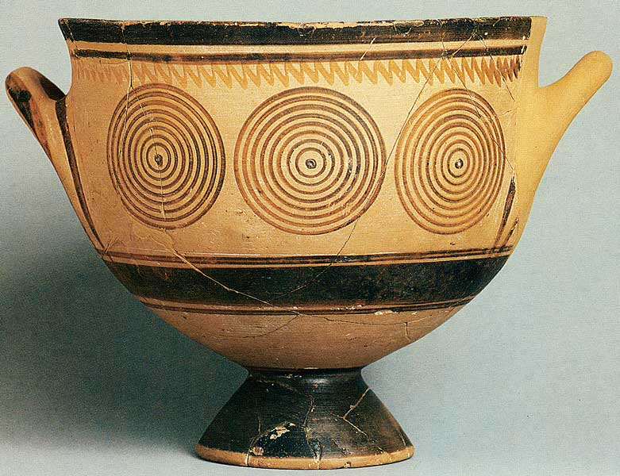
EARLY (OR PROTO) GEOMETRIC POTTERY
Around 1000 BC
More stable vessel with the feet and neck more articulated
Painted circles, semi-circles, horizontal lines and the upright triangular points
Notes:
The first distinctive Greek pottery style first appeared around 1000 BC or perhaps even earlier. Reminiscent in technique of the earlier Greek civilizations of Minoan Crete and the Mycenaean mainland, early Greek pottery decoration employed simple shapes, sparingly used. Proto-Geometric pottery, however, differs from Minoan and Mycenaean in shape. The centre of gravity of the vase is moved downwards (creating a more stable vessel) with the feet and neck more articulated.
The most popular Proto-Geometric designs were precisely painted circles (painted with multiple brushes fixed to a compass), semi-circles, and horizontal lines in black and with large areas of the vase painted solely in black. A new motif on the bases of vessels was the upright triangular points which would endure for centuries and become a staple feature of the later black-figure pottery design.

Slide 4
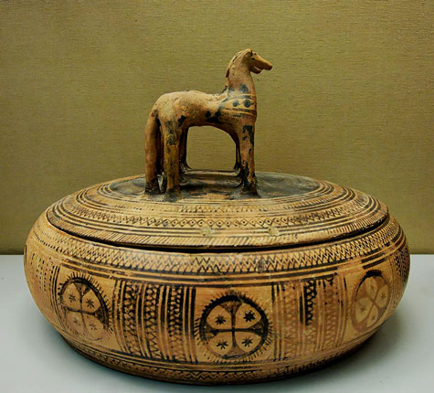
GEOMETRIC POTTERY
Around 900 BC
Rectangular body, bold linear designs with vertical line decoration on either side
Maeander design first appeared in this period
8th century BCE stylized human figures, birds, and animals
7th century BCE Orientalizing style popular in Corinth: stylized plants, animal friezes and curved lines
Notes:
From around 900 BCE the full Geometric style appeared and favoured the rectangular space on the main body of the vase between the handles. Bold linear designs (perhaps influenced by contemporary basketwork and weaving styles) appeared in this space with vertical line decoration on either side. It was in this period that the Maeander design first appeared (perhaps inspired by the practice of wrapping leaves around the rims of metal bowls), destined to become forever associated with Greece and still going strong on everything from plates to beach towels even today. The lower portion of Geometric vessels were often painted in black and separated from the rest of the vase using horizontal lines. An interesting Geometric style shape appeared which was the circular box with a flat lid, on top of which, one to four horses acted as a handle.
From the 8th century BCE, Geometric pottery decoration began to include stylized human figures, birds, and animals with nearly all the surface of the vase covered in bold lines and shapes painted in brown and black.
Towards the end of the period in the 7th century BCE, the so-called Orientalising style became popular in Corinth. With its eastern trade connections, the city appropriated the stylised plants (e.g. lotus, palm, and the tree of life), animal friezes (e.g. lions), and curved lines of Egyptian and Assyrian pottery to produce its own unique Greek version. The rest of eastern Greece followed suit, often preferring red on a white slip background. Athens also followed the new trend and it became widespread with, for example, the Cyclades also producing pottery in this new freer style, often on very large vases and with more spacious decoration. At the end of the 7th century BCE, Proto-Corinthian pottery reached new heights of technique and quality producing the finest pottery yet seen, in firing, shape, and decoration. The black stylized figures became more and more precisely engraved and were given ever more detail, grace, and vigour. The celebrated black-figure pottery style was born.

Slide 5
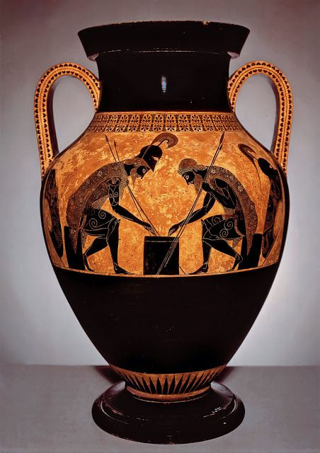
BLACK-FIGURE POTTERY
6th century BC
Black images silhouetted against the natural red clay background
White or purple paint could be added
Fine details and postures of the figures
Black-figure vases often told a narrative
Vase by Exekias
Notes:
The Black-figure style really did not dominate until the 6th century BC. Although first produced in Corinth, then with fine examples made in Laconia and southern Italy (by Euboean settlers), it would be the potters and painters of Attica who would excel above all others in the black-figure style, and they would go on to dominate the Greek market for the next 150 years. Not all figures were painted black as certain color conventions were adopted, such as white for female flesh and purple-red for clothes and accessories. A greater interest in fine details such as muscles and hair, which were added to the figures using a sharp instrument, is characteristic of the style. However, it is the postures of the figures which also mark out black-figure pottery as the zenith of Greek vase painting. The finest figures are given grace and poise and often illustrated in the moments before actual movement or resting after exertion. The famous vase by Exekias, with Ajax and Achilles playing a board game during the Trojan War, is an excellent example of the dignity and energy black-figure painting could achieve. In addition, black-figure vases often told, for the first time, a narrative. Perhaps the most celebrated example is the Francois Vase, a large volute krater made by Ergotimos and painted by Kleitas (570-565 BCE) which is 66cm high (26 inches) and covered in 270 human and animal figures depicting an astonishing range of scenes and characters from Greek mythology. Typical other vessels of the black-figure style are amphorae, lekythoi, kylikes, plain cups, pyxides (small lidded boxes) and bowls.

Slide 6
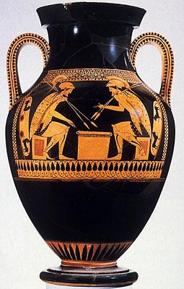
RED-FIGURE POTTERY
Around 530 BC
More realistic portrait of the human figure
More difficult but the design can be seen better at a distance and it leaves the contour of the pot more visible
Narrative’s to be read by turning the cup in the hand
Notes:
The black-figure technique was replaced by the red-figure technique (red figures created by painting their outline with a black slip background) around 530 BCE which would endure for the next 130 years or so. The two styles were parallel for some time and there are even ‘bilingual’ examples of vases with both styles but the red-figure, with its advantage of the brush over the graver, could attempt to more realistically portray the human figure and eventually it became the favored style of Greek pottery decoration. Perhaps influenced by contemporary wall painting techniques, anatomical detail, diverse facial expressions, greater detail in clothing (especially of folds, following the new fashion of the lighter chiton dress which also fascinated contemporary sculptors), greater attempts at portraying perspective, the overlapping of figures, and the depiction of everyday life such as education and sporting scenes are all characteristic of this style.
The red figures are reserved and the background is painted. This is more difficult but it allowed the design to be seen better at a distance and it leaves the contour of the pot more visible.
The shapes of red-figure vessels are generally those of the black-figure style. An exception is the kylix which becomes shallower and with a shorter foot, almost becoming a third handle. In addition the painted narrative is to be read by turning the cup in the hand. Other minor modifications are the hydra, which becomes a little fuller in figure and the slimmer neck-amphora. Lekythoi of this period commonly had a white background as did (more rarely) cups and boxes.

Slide 7
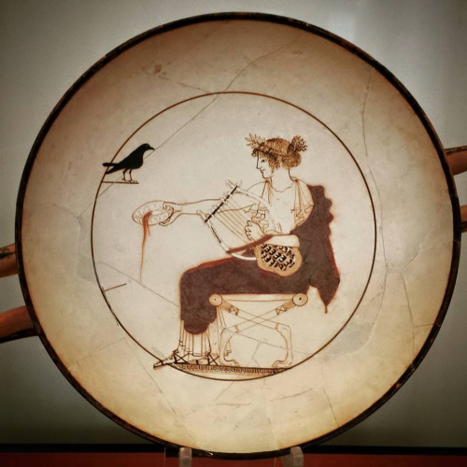
WHITE-GROUND POTTERY
Around 500 BC
It developed in the region of Attica
Less durable, primarily made for ritual and funerary use
Meant to make the vases appear more valuable
Notes:
It developed in the region of Attica, dated to about 500 BC. It was especially associated with vases made for ritual and funerary use, if only because the painted surface was more fragile than in the other main techniques of black-figure and red-figure vase painting.
In white-ground pottery, the vase is covered with a light or white slip of kaolinite. A similar slip had been used as carrier for vase paintings in the Geometric and Archaic periods. White-ground vases were produced, for example, in Ionia, Laconia and on the Cycladic islands. But only in Athens did it develop into a veritable separate style beside black-figure and red-figure vase painting. For that reason, the term white-ground pottery or white-ground vase painting is usually used in reference to the Attic material only.
The light slip was probably meant to make the vases appear more valuable, perhaps by eliciting associations with ivory or marble. However, in no case was a vessel's entire surface covered in white slip. It has also been conjectured that this form of painting emerged in order to emulate the more prestigious medium of wall painting, but the thesis has been elusive of proof.
White-ground vase painting often occurred in association with red-figure vase painting. Especially typical of this are kylikes with a white-ground interior and a red-figure exterior image. White-ground painting is less durable than black- or red-figure, which is why such vases were primarily used as votives and grave vessels.

Slide 8
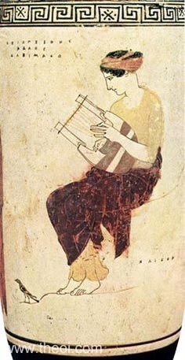
THE DECLINE OF GREEK POTTERY
By the end of the 5th century BC
Metal bowls and vases were now favored by the rich
Limitations of the curving pot surface and the limited colors
Pottery painters could no longer compete with the painters of larger works such as wall paintings
Notes:
By the end of the 5th century BC, pottery painting seems to lose its status as an art form and there are probably many causes. Some suggest that metal bowls and vases were now favored by the rich. Another reason could be the inherent limitations of the curving pot surface and the limited colors, meant that pottery painters could no longer compete with the rapid strides toward naturalism taken by painters of larger works such as wall paintings. The most inventive artists no longer wanted to design or decorate terracotta pottery; they preferred the color and breadth of wall painting or other crafts.

Slide 9
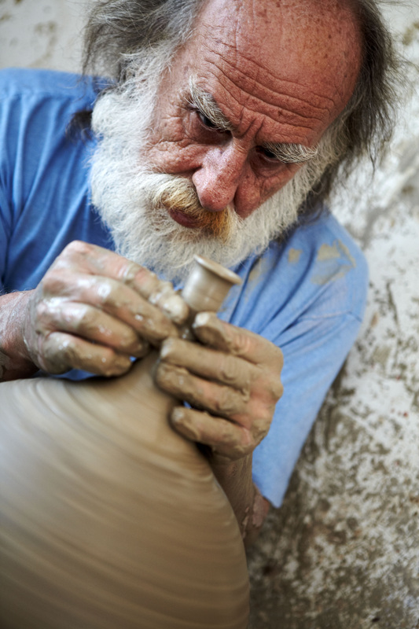
MODERN GREEK POTTERY: ANDREAS MAKARIS
Family of potters: received his first lessons at the potter’s wheel at a very young age, a fifth generation potter
Graduated from the School of Ceramics
5 awards at the Greek National Pottery Exhibition
Lives and works in Santorini since 1985, inspired by the island
Works with us for 4 years now, in teaching pottery to our students
Notes:
Born in Athens in 1951 into a family of potters, he received his first lessons at the potter’s wheel at a very young age from his grandfather, Christos Makaris, who was born in Naxos.
He graduated from the School of Ceramics in 1972, where he later taught for six years.
In 1973, he entered his work in the PanHellenic Ceramics Exhibition for the first time and won second prize in art ceramics. The same exhibition, held every year in Marousi, Athens, awarded him a further four prizes.
He maintained a workshop in Athens until 1984. Since 1985, he has been living and working in Santorini, seduced by the magical light, the imposing landscape, the distinctive traditional village architecture, the arid yet blessed vineyards, and most of all by the culture, which after so many millennia remains an endless source of inspiration.
Perpetually concerned with the future of this ancient art form in Greece – now that the School of Ceramics no longer exists – he is unrelenting in passing on his invaluable knowledge and, especially, his love of the art of ceramics to future generations.

Slide 10
Modern Greek Pottery
http://www.visitgreece.gr/en/culture/museums/centre_for_the_study_of_traditional_pottery
https://www.etsy.com/market/modern_greek_pottery
https://www.etsy.com/market/greek_pottery
https://www.alibaba.com/showroom/modern-greek-pottery.html

Slide 11
RESOURCES
http://www.ancient.eu/Greek_Pottery/
http://www.britishmuseum.org/pdf/Greece%20Pots%20_v2_.pdf
http://earthandwater.weebly.com/

