Slide 1
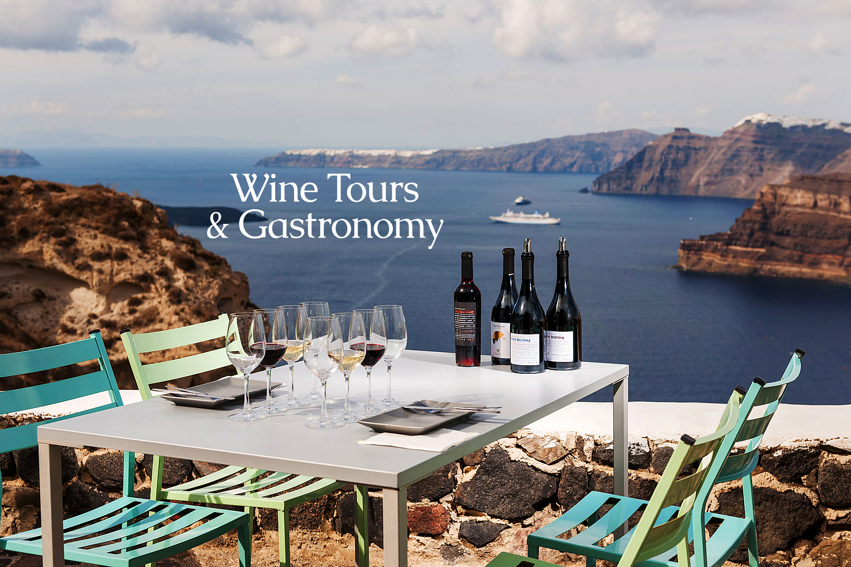
Natural Heritage
Αn original presentation prepared by the HELLENIC CULTURE CENTRE VIP Project EU 11

Slide 2
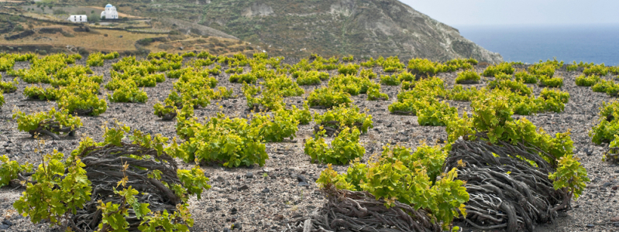
NATURAL HERITAGE
Formed by lava, volcanic ash and light stone
Rich in sulphur, porcelain and iron
Poor in organic matter and nutrients
Particular role of pumice stone and sea fog
No diseases (thanks to dry and hot climate)
Unique taste of agricultural products
Notes:
The volcanic eruption formed a soil of unique texture which includes lava, volcanic ash and light stone. That special composition gives birth to grapes of distinctive flavour-profile, hosts low-yield vines and works as a natural shield from diseases. The vineyard in Santorini is self-rooted as it was never affected by the phylloxera, thanks to the lack of clay in the soil.
The dry land and the volcanic soil of Santorini give a great taste to all the agricultural products of the island. On this dark and dry land, one wouldn't expect anything to grow, but some special crops are fruitful. The earthquake was catastrophic for Santorini, but it was the salvation of the vineyards, tomatoes and the split pea cultivations.
The soil of volcanic origin has a minimum amount of organic matter and is poor in nutrients.
Pumice traps humidity during night time and early morning hours. It functions as a water tank, firstly by storing water and then by distributing the necessary amount of water to the vineyards.
The particular hot and dry climate of the island in combination with the volcanic soil prevents the development of diseases. For instance, phylloxera, an insect that plagues all vineyards on the planet, failed to survive in the climate of Santorini.
It is rich in ash, sulphur, porcelain and iron.
Despite these advantages, the growing conditions of Santorini are made more difficult because of the lack of rain, with an average of only 400mm per year. The rains fall mostly in the winter and seeps through the porous soil and rock, gathering deep into the earth, where it remains until the summer’s heat draws it near the surface to nourish the vines. The only other source of water available comes in the form of sea fog that envelops the island at night due to the reaction of the active volcano with the surrounding sea.

Slide 3
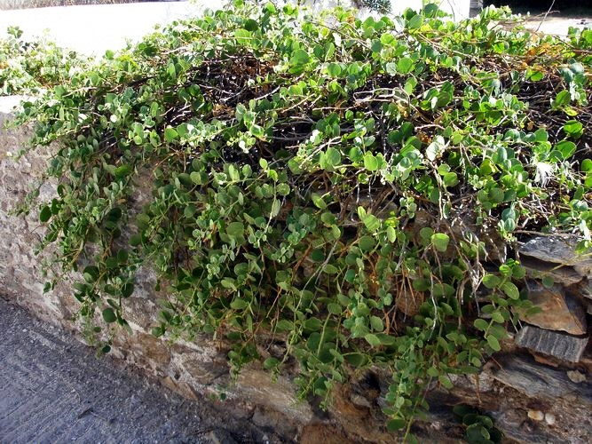
CAPERS
Low-maintenance plant
Not cultivated
Rocky slopes of the Caldera or dry-stone walls
Collected from late June to end-August
Limited production
Labour-intensive harvest
Plant entirely edible
Source of calcium, potassium, magnesium, sodium and zinc
Useful against water retention
Used as painkiller
Notes:
The caper bush is a low-maintenance plant that does not like to grow in fields, near cities or in good soil. With something of the briny taste of the sea, it grows on the rocky slopes of the Santorini caldera and near the dry-stone walls built by farmers to contain soil erosion. The buds and leaves are collected from late June through end-August, stored in jars with brine and used in salads or tangy sauces. In Santorini’s traditional cuisine, they are also used in fava dip, giving it a nice tart flavour, and are served along with crunchy, fried fava balls.
The availability of capers is similarly limited. The caper plant is not cultivated, but can be found only in the wild, sprouting atop the island’s craggy rocks and other unlikely places. It is said that ants carry its seeds to their winter nests so that, a year later, a new caper bush springs up. Farmers and household cooks take to the rocky expanses at the end of April to collect the buds and any leaves.
Their limited production and labor-intensive harvest make them an expensive delicacy, but the flavor is out of this world. Even though it is a naturally briny product, it is said that the best capers grow on the hills, not by the sea. The entire plant is edible, from the small buds to the leaves and shoots. Pickled, baked with vegetables or sprinkled over a dollop of pureed split peas, they offer an interesting, crunchy texture to any dish and act as a condiment that lends food a pleasantly sea-bitter taste.
Capers are a rich source of calcium, potassium, magnesium, sodium and zinc, as well as flavonoids. They have been considered to have healing powers since antiquity. Also a mild diuretic, they are used to combat water retention and, possibly because of their anti-inflammatory properties, as a painkiller. The plant is also attributed with antioxidant qualities.

Slide 4
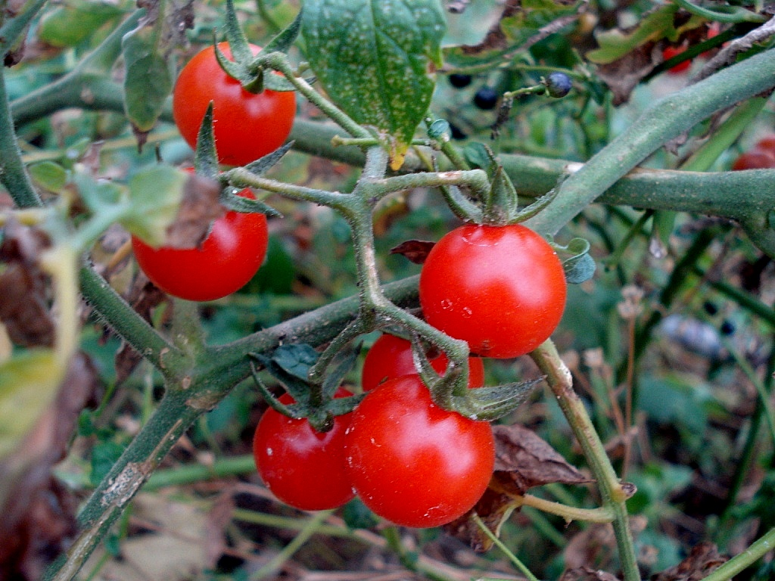
CHERRY TOMATOES
Lycopersicon esculentum, Solenaceae family
From Egypt in mid 19th century
Grown only on Santorini
PDO from 2013
Sweet flavour with strong acidity
Collected in late June
Seeds saved to be replanted nine months later
Today 60 hectares of cherry tomatoes cultivated
3-4 kg of tomatoes to produce 1 kg of triple-concentration tomato paste
Notes:
The scientific name for this unique tomato is Lycopersicon esculentum, of the Solenaceae family. It is a landrace, meaning that it is grown only on Santorini. It may be small in size – the average weight being at just 20 grams – but it is miraculous. It has a deep red color, a thick skin with clear vertical lines, compact flesh that does not contain a lot of water and many seeds. The flavor is very sweet with strong acidity. It is also rich in inverted sugars (glucose-fructose) and aromatic oils. Its Protected Designation of Origin means that it can only be grown on Santorini, Thirasia, Palia and Nea Kameni, Aspronisi, Christiana and Askania – that is the islets off the main island’s coast.
The tomatoes would be collected in wicker baskets in late June.
The seeds were treasured like a talisman, to be replanted nine months later, while the juice was boiled in great metal pots. In July, the flat roofs of houses would turn from white to red, as north-facing wooden racks were filled tomato juice left to dry in the sun. Day by day, with the hot Cycladic sun beating down on the terraces, the juice would thicken as the water evaporated.
In the past, households would only grow as much as they needed to see them through the year. Gradually, however, the locals began to discover the commercial value of their tomatoes and set up small processing units, the island’s first canneries, where the fruit would be passed through makeshift sieves and the condensed tomato juice poured into cans, one jug at a time. Today, 60 hectares of cherry tomatoes are cultivated across the island, yielding 300 tons destined for the new facilities of the Santo Wines Cooperative, the last surviving processing unit on the island. It takes about 3-4 kilograms of fresh fruit to produce one kilo of triple-concentration tomato paste of the type originally made by the locals. Other than paste, juices with varying degrees of concentration and whole, canned tomatoes, the unit also produces a tomato and Vinsanto wine sauce, sun-dried tomatoes and sundry jars and tins of a product that is now exported around the world.
The same casual approach was adopted to make the tomato fritters that are still served at almost every taverna on the island, with the tomato being grated and mixed with all sorts of garden greens such as chard, leeks and onions, along with a few teaspoons of flour to bring it all together. Any tomatoes that remained at the end of July and were still fleshy would be threaded on a string and left to dry in the sun. Once they were well dehydrated, they would be stored in the cool of the canava, the storage area dug into the rock. These would later be used to make rice dishes or to add some flavor to simple vegetable stews.
The seeds first made it to Santorini through the Suez Canal in the mid-19th century. It is said that when the ships of Santorini docked there for supplies, the sailors would eat Egypt’s famed cherry tomatoes and bring seeds back. As a plant, it adapted well to Santorini’s particular climate of little rainfall, strong northerly winds and an abundance of sunshine (estimated at an average of more than 200 days a year). And it is the volcanic soil, with all its “difficulties” that ultimately imbued it with its special characteristics and sweetness.
The Santorini cherry tomato has the highest lycopene content among other tomato varieties, a phytochemical substance with major antioxidant properties, which, according to the latest studies from the University of Cambridge, lowers the chances of heart disease and helps prevent cancer.

Slide 5
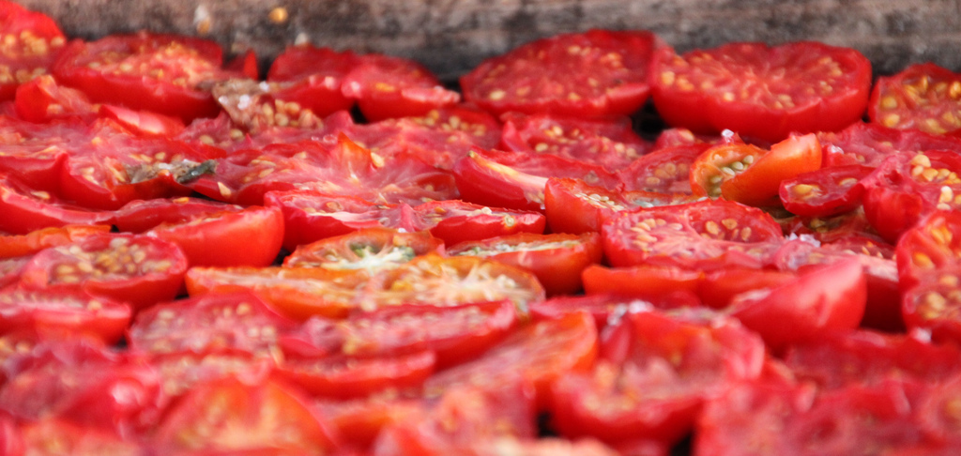
SUN-DRIED
TOMATOES
In July Santorini’s rooftops become red for tomatoes
Cut tomatoes in half
Add salt and pepper (to prevent flies)
Spread in the sun
After eight days:
  Moved in a cool place
  Put in jars with vinaigrette
Notes:
Santorini is famous for its vine tomatoes, which years ago used to be exported abroad in large quantities. They were so popular, that thirteen tomato paste/canned factories had opened in Odessa, of which only one is still active. The elderly say that due to the stupendous tomato and wine exports, the communication between Santorini and Odessa was once better than the one between Santorini and Pireus in Athens.
It was said that the tomato surplus was thrown in the sea, which turned red. The people of Anafi used to find tomatoes on the beaches of their island. Santorini's tomatoes are very tasty, especially in sauces or salads. They're also sun-dried as follows: they're cut in half and spread in the sun, after adding salt and pepper to prevent flies. After eight days in the sun, they get really dry and are moved in a cool place or are put in jars with vinaigrette. The vinaigrette keeps them in very good condition, but not for more than 1-2 months, because then they turn bitter.

Slide 6
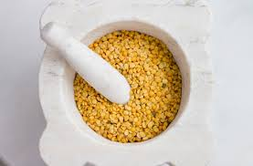
FAVA
Cultivated on the island for more than 3500 years
Santorini’s PDO
Family production
1 year: collected and cropped
2 year: peeled
No pesticedes
Rich in proteins and carbohydrates
Rich in of vitamin B1 (thiamine), iron, copper, phosphorus, calcium and magnesium, rich in folic acid and manganese
Useful to low bad cholesterol, maintain proper blood sugar level
No sodium (good for people with high blood pressure)
Notes:
Santorini’s fava (split-peas) comes with references that date back to antiquity. According to prehistoric remains of stored crops and seeds from excavations at Akrotiri, the local variety of Lathyrus clymenum has been cultivated exclusively on the island for more than 3,500 years, long before the eruption of the volcano. In fact, Pedanius Dioscorides, a renowned 1st-century physician and botanist, separated the species of plant from which Santorini’s fava is made from other Papilionoideae species that produce this bean in other parts of the world.
Every family in Santorini has always produced its own fava. The unique make-up of the island’s soil, the climatic conditions and, as odd as it sounds, the aridity have helped shape this product, with its velvety texture and sweet flavor.
The first year they are cropped and the next they're peeled. If the peel is removed the same year it sticks and the fruit crumbles. The devoted split peas producers, produce 100-200 kilos of produce and avoid the use of pesticides by the following procedure: they put the split peas into a metal barrel and cover it with plastic, binding it air tight by a bicycle inner tube, so that insects can't get to the fruit. They also use oleander leaves which are natural preservatives.
Theran fava is also very rich in protein (with a content of around 20%) and carbohydrates, while it is smaller in size than other varieties.
The seed is planted in December and once it grows, it is left to dry. Farmers collect it early in the day as the morning dew prevents the lightweight grains from scattering to the ground. These are taken to the open-air mill, where donkeys turn the grinding stone to help remove the outer skin. They are then stored in wooden barrels, covered in sand and set aside in a dry space to mature. The longer they rest, the easier they are to peel and crack, making cooking them easier. Production, however, is in constant decline and today the island produces just 150 tons on 180 hectares, which is why the peas are so pricey.
It was recently awarded Protected Designation of Origin, meaning that it needs to be grown in a particular way on certified farms and only on Santorini, and also needs to be ground by certified mills.
This delicious pulse is served as a paste, with a drizzle of fresh lemon juice, olive oil and finely diced onions. It is a lovely side dish with fish and shellfish. It can also be served as a soup or used to enrich salads and risottos.
Nutritional Value
A good source of vitamin B1 (thiamine), iron, copper, phosphorus, calcium and magnesium, rich in folic acid and manganese, it helps lower bad cholesterol (LDL) and maintain proper blood sugar levels, boosts the heart and digestive system, and protects the large intestine from cancer. The fact that it does not contain sodium makes it ideal for people with high blood pressure.

Slide 7
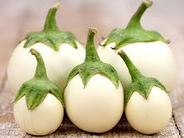
WHITE AUBERGINES
From Egypt in mid 20th century
Juicy and sweet
Not as bitter and seedy as regular eggplants
Rich in vitamin C, calcium, potassium, magnesium, iron and phosphorus
Useful to protect brain cells, to boost immune system and to low cholesterol
Notes:
Santorini’s trademark aubergine (Solanum avigerum) has white skin and belongs to the broader Solanaceae family, but to a specific variety that is grown only on the island. Its seed is believed to have come from Egypt in the mid-20th century and to have adapted very well to the island’s soil and microclimate. It is round, with firm flesh, and does not have the bitterness of regular purple eggplant or too many seeds. It is also very juicy and sweet, while locals say that it does not absorb a lot of oil when it is fried.
It is rich in vitamin C, calcium, potassium, magnesium, iron and phosphorus. Thanks to the powerful antioxidant action of nasunin, it protects brain cells, boosts the immune system and helps lower cholesterol.
The white eggplant harvest coincides with that of the cherry tomato (planted in May, gathered in July), which gave rise to a number of dishes combining the two.
The flavor of this eggplant is almost indescribable; it is very sweet, with no seeds and rich flesh. It can be found today in the island’s restaurants in many forms; as a puree, in a savory millefeuille, in fritters, in moussaka and in scrambled eggs. Since yields are very low, it is extremely difficult to find off the island, with supply only just sufficient to cover demand on Santorini, so don’t pass up on the opportunity to taste it.

Slide 8
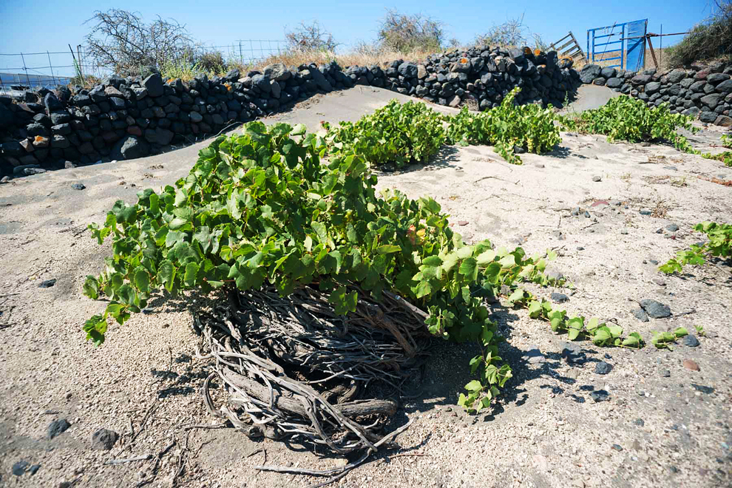
GRAPES
Vines date back 5000 years
PDO wines
Countless international awards to Assyrtiko
Lack of rain, wind, high temperatures and humidity
From the 1960’s decrease of lands cultivated with vines
Organic methods of cultivation
No artificial irrigation
Irrigation made by natural humidity, sea mist and pumice stones
Everything is made by hand
Particular type of pruning:
The “Kouloura”
Notes:
The vineyard of Santorini, one of the most ancient in the world with a 3,500-year history, consists of a World Heritage site.
Indigenous varieties: Assyrtiko thrives in Santorini, the birthplace of the famous Greek variety. As a single varietal or blended with the aromatic Athiri and the delicate Aidani, it offers the Santorini Protected Designation of Origin (PDO) wines. White, dry wines with high acidity, intense minerality and a remarkable ageing potential.
Assyrtiko from Santorini has racked up countless international awards including Wine Spectator scores in the 90s, a recent gold medal from Decanter (Britain’s equivalent of the Wine Spectator), and another gold medal from Bordeaux’s International Challenge of Wine.
Wild, windswept and arid, it is not easy for vines to flourish on Santorini. They must contend with scorching daytime temperatures, high humidity at night in spring and summer, an almost total lack of rainfall and, above all, fierce winds. And these aren’t the only difficulties facing the island’s viniculturalists. The vineyards themselves are relatively small and yields are poor. Only 1,400 hectares are still being cultivated and the average production per hectare is low (2,500-3,500 kg) in comparison to the rest of Greece (10,000 kg).
The Vineyard
There is archeological evidence supporting the cultivation of the vine on Santorini that dates back almost 5000 years. However, it was the eruption of around 1600BC that made the unique wines of Santorini what they are today. The explosion left behind a mixture of volcanic ash, pumice stone and pieces of solidified lava and sand, which together make up the soil of Santorini, known as “aspa”. The soil has little to no organic matter, but is rich in essential minerals, except potassium, creating wines with a naturally low pH level and high acidity.
The Terroir
The volcanic soil in which the indigenous varieties of Santorini grow is responsible for the unique character of the wines. Additionally, the lack of clay in the soil gives the vines a natural immunity from Phylloxera.
Despite these advantages, the growing conditions of Santorini are made more difficult because of the lack of rain, with an average of only 400mm per year. The rains fall mostly in the winter and seeps through the porous soil and rock, gathering deep into the earth, where it remains until the summer’s heat draws it near the surface to nourish the vines. The only other source of water available comes in the form of sea fog that envelops the island at night due to the reaction of the active volcano with the surrounding sea. The sea mist is absorbed by the soil, pumice and other volcanic rock and is returned to the vines during the day, when it is needed most. This salty spray that covers the grapes provide another dimension and special quality, boosting minerality and adding a pleasing, slightly briny character to the wine.
Cool, refreshing winds from the north called, “meltemia,” blanket the island during the summer, decreasing the temperature dramatically at night. This helps maintain the already bright acidity that Assyrtiko and the other native varieties inherently possess.
These revitalizing winds also keep the vines from becoming infected with Botrytis and mildew, which greatly reduces the need to treat the vines.
Cultivation
Throughout the island of Santorini, there is an estimated 1400 hectares of vineyards still under cultivation. This has decreased from 2500 hectares planted in the 1960’s due to a combination of the island’s popularity as a travel destination and the increasing disinterest of the new generations of growers because of the extreme difficultly in vineyard maintenance. Though only a handful of the vineyards are certified organic, most of the growers cultivate their grapes using organic methods because of the natural resistance to disease and pests that the climate and volcanic environment have created.
Dry farming
The vines are not irrigated artificially and the rainfall is rare. Therefore the plants’ watering is dependent on the natural humidity and the sea mist; absorbed by the volcanic soil, they offer the necessary hydration.
Manual work
From pruning to harvesting, everything is done by hand. The vintners have invented a distinct way of pruning, called “kouloura”. The vines stay close to the ground and form a spiral, a natural basket that hosts the grapes and protects them from the strong wind. In areas of notable slope, the vine growers have built stone terraces, known as “pezoules” in order to facilitate the cultivation and to maximize the absorbance of rainwater.

