Slide 1
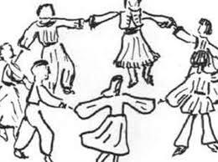
INTRODUCTION TO THE GREEK TRADITIONAL DANCES
Αn original presentation prepared by the HELLENIC CULTURE CENTRE
VIP Project EU 13

Slide 2
Ι have some questions for you
Do you dance? Do you dance traditional dances?
What dances do you like?
Do you have traditional dances in your country?
Have you ever danced any Greek traditional dances? Do you know some of them?
Αn original presentation prepared by the HELLENIC CULTURE CENTRE VIP Project EU

Slide 3
Traditional dances in Greece
Dancing is taught in school for all children as part of physical education classes.
In Greece, dancing is part of the current culture and the people’s everyday life, not a custom that is simply kept alive.
Dancing is practised by people of all ages, from very small children to very old people
Greek people also love to sing a lot !
Αn original presentation prepared by the HELLENIC CULTURE CENTRE VIP Project EU

Slide 4
PANIGYRIA - Greek Traditional Feasts
The traditional feasts are a part of the Greek everyday culture
They are mostly based on religious celebrations of Saints’ Name Day
The preparations are with the help of all the villagers
At the feasts there is Music, Dance and Treats
Treats come from the “agapei” custom, where free food was distributed to the poor
Feasts like these serve as an excuse for people who fought to meet and make up
Αn original presentation prepared by the HELLENIC CULTURE CENTRE VIP Project EU

Slide 5
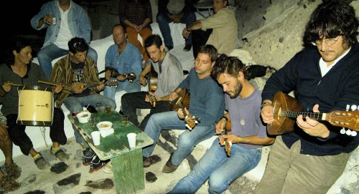
Panigyria in Santorini
feasts in the 1200+ churches
At Finikia, there is the famous feast of Saint Matrona, the biggest one of all that lasts three days and nights.
There is a lot of music, singing and dancing
n original presentation prepared by the HELLENIC CULTURE CENTRE VIP Project EU

Slide 6
How many dances do we have?
Around 200 dances!
Every region in Greece has its own traditional Dances → These dances have variations unique from village to village
Every dance has its characteristic steps and it own rhythm
n original presentation prepared by the HELLENIC CULTURE CENTRE VIP Project EU

Slide 7
Traditional Dances
They are divided according to:
The theme (Religious, Warfare, Love)
The way they are danced (Face to face, Circular, solo)
The gender (Dances for Men, Women or Mix ed)
The location (Ethnic or Local: Nisiotika (island), Thracian etc.)
n original presentation prepared by the HELLENIC CULTURE CENTRE VIP Project EU

Slide 8
Why/where do we dance in Greece?
Dancing is part of everyday’s culture and is practised on many occasions, there isn’t a need for it to be particularly special. Greek people love celebrating !
At weddings, christenings, other special events
During traditional celebrations / festivals like Panygiria
During “Glendia” , big parties that can be thrown anytime by groups of people or families and are defined by abundant eating, drinking, singing and dancing
n original presentation prepared by the HELLENIC CULTURE CENTRE VIP Project EU

