Slide 1
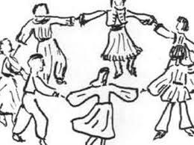
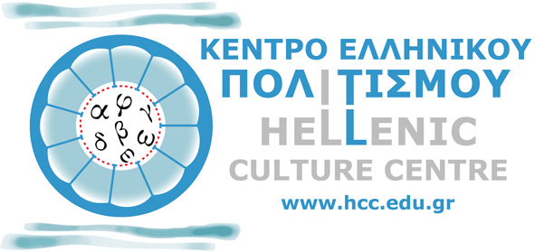
INTRODUCTION TO THE GREEK TRADITIONAL DANCES
Αn original presentation prepared by the HELLENIC CULTURE CENTRE
VIP Project EU 14

Slide 2
Zeibekiko
Zeimbekiko took its name from Zeimpekides
The dance itself comes from Thrace
It is a solitary dance even though there are variations to the dance like the Aivaliotiko zeimpekiko or Aptaliko
It is mostly improvised and danced by men, with a lot of dynamic and wide movements
Read more : Παραδοσιακοί χοροί της Ελλάδας | Πάρε-Δώσε http://www.pare-dose.net/85#ixzz3dKSUMqEM
Αn original presentation prepared by the HELLENIC CULTURE CENTRE VIP Project EU

Slide 3
Balos
Paired dance of the islands
It represents the attraction between a man and a woman
There are no rough movements
It is a dance from and for the people
The dancers hold handkerchiefs
Διαβάστε περισσότερα/ Read more: Παραδοσιακοί χοροί της Ελλάδας | Πάρε-Δώσε
Αn original presentation prepared by the HELLENIC CULTURE CENTRE VIP Project EU

Slide 4
Tsifteteli
It is most probably originated from Turkey
The equivalent word in turkish or Armenian mean “double(tsifte) chord(teli)”
It is danced alone or in pairs
It is a sensual dance focusing on arms, hips and torso movements
Αn original presentation prepared by the HELLENIC CULTURE CENTRE VIP Project EU

Slide 5
Syrtaki
Considered on of the most popular dances in Greece, especially by foreigners...
...But It is not a traditional dance
It is made of sliding dance steps
Read more: Traditional Greek dances, Pare-Dose http://www.pare-dose.net/85#ixzz3dKFdjHwl
Αn original presentation prepared by the HELLENIC CULTURE CENTRE VIP Project EU

Slide 6
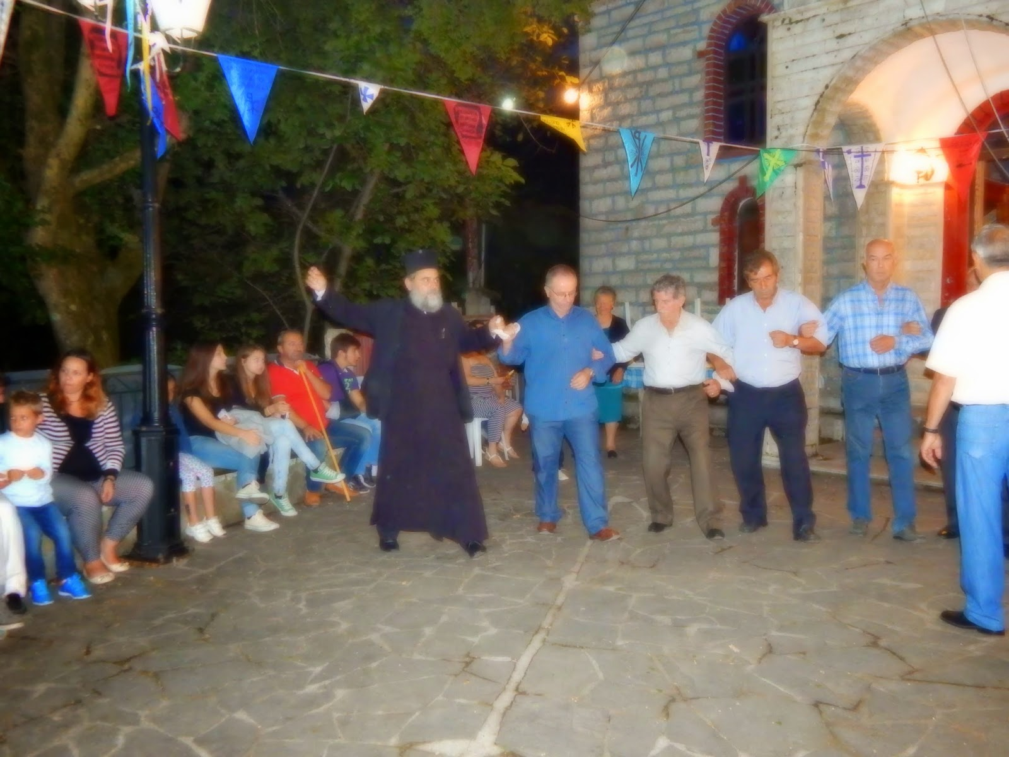
Everyone dances
Αn original presentation prepared by the HELLENIC CULTURE CENTRE VIP Project EU

