Slide 1
Changes in the Cultural Landscape The Tomato Production and Factory in Santorini- turned into a museum Αn original presentation prepared by the HELLENIC CULTURE CENTRE VIP Project EU 15

Slide 2
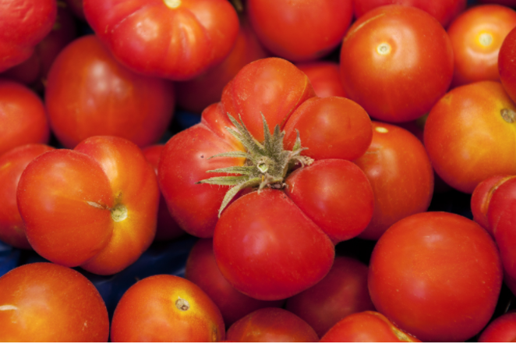
Santorini’s Cherry Tomato
The small-fruited Santorini tomato, a Protected Designation of Origin (PDO) product since 2006, is one of the most famous and traditional products of Santorini.

Slide 3
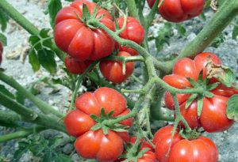
Santorini’s Cherry Tomato
The Santorini tomato (tomataki Santorinis)
deep red color
high seed & carbohydrate content
a sweet, strongly acidic taste
round, slightly flattened shape
weigh 15–27 grams
generally ripen in 80–90 days.

Slide 4
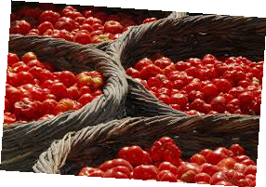
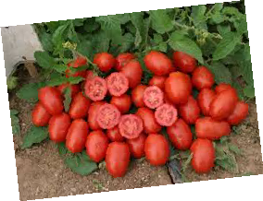
Tomataki – cherry tomato
No water
Sweet, tasty, hard
The tomato paste is unique
Price four times higher
Today can only be found in the Santo Wines Cooperative and in Sklavenitis super market (Messaria)
You may buy also from local producers, Andonis Arvanitis and Petros Oikonomou in Megalochori

Slide 5
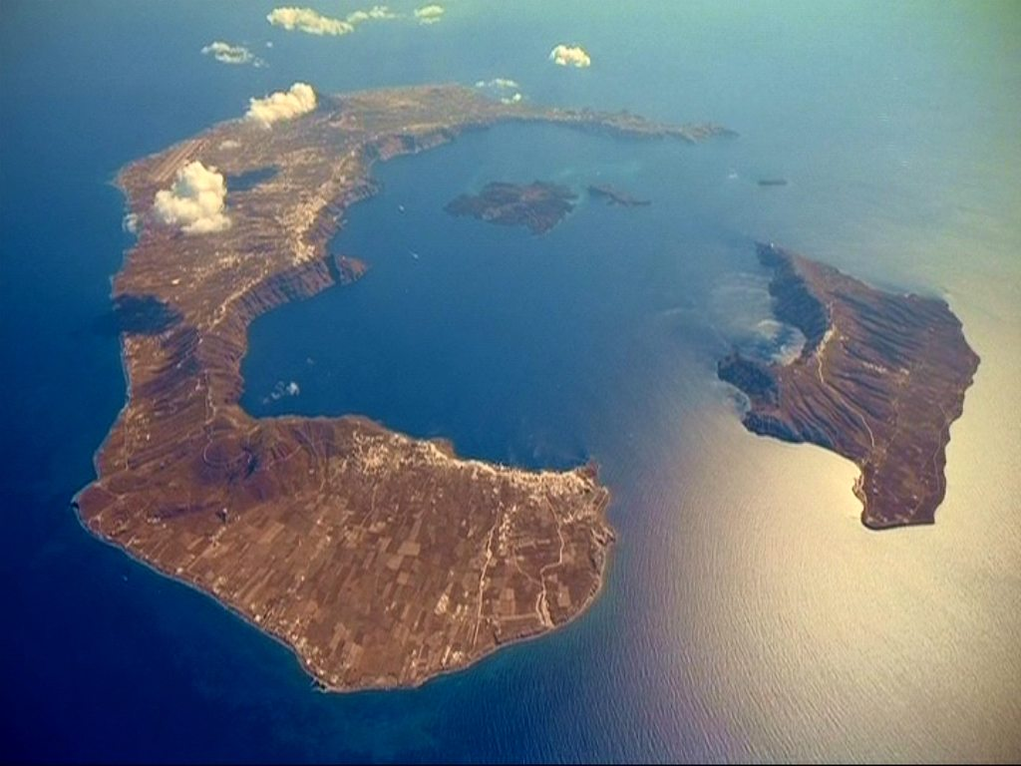
Key Feature
Lack of rainwater and frequent watering
also a key feature of the wider Thera agricultural products
it’s why they are called anhydrous (waterless) tomatoes
the water of the atmospheric humidity, which comes from the evaporation of the caldera is retained in the pores of the pumice stones that exist on the island.

Slide 6
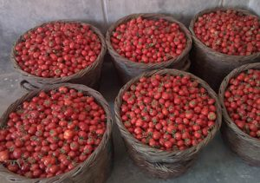
19th century
first sown by a Christian monk named Fragkiskos in the year 1818 at the Capuchins Monastery
not certain whether the tomato got accustomed to Santorini's weather and soil conditions or if it belongs to an altogether unique species
organized cultivation of tomatoes in Santorini began from the year 1875
The Santorini tomato is that it has remained original to this day and never ever has it been implanted with another variety.

Slide 7
19th century
A popular Santorini legend has it that the first tomato seeds were brought from Suez. The soil of Santorini, “aspa”, is getting solid, strong and waterproof, when we mix it with lime and water. This materials was used for the Suez canal.
Santorini used to be a flourishing maritime kingdom and its seafarers used to frequent the Suez for trading.
During one such trip to the Suez that the Santorini seamen brought the seed to the island and began cultivating the tomato.

