Slide 1
Changes in the Cultural Landscape The Tomato Production and Factory in Santorini - turned into a museum Αn original presentation prepared by the HELLENIC CULTURE CENTRE VIP Project EU 16

Slide 2
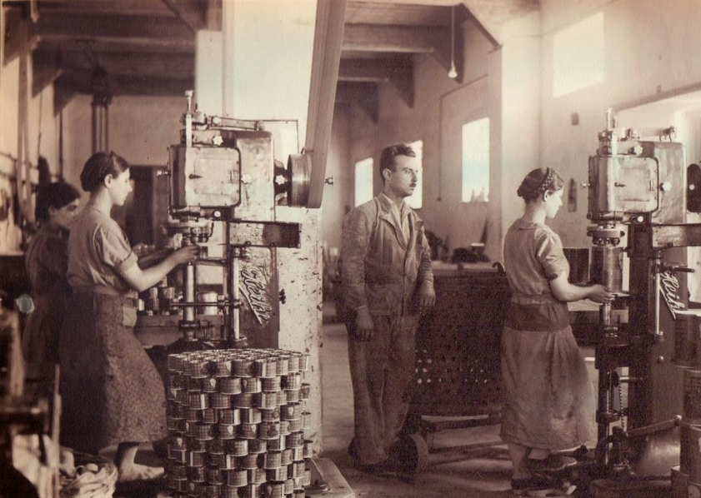
20th century
1922: 1st industrial unit was set up by Dimitrios Nomikos at Monolithos,
Nearly 20.000 acres of land were cultivated with tomatoes, and as many as 14 processing factories in business.
P. Nomikos:“It was something like a social place for them, like the church on Sunday.”
Photograph from the flourishing years of the industry

Slide 3
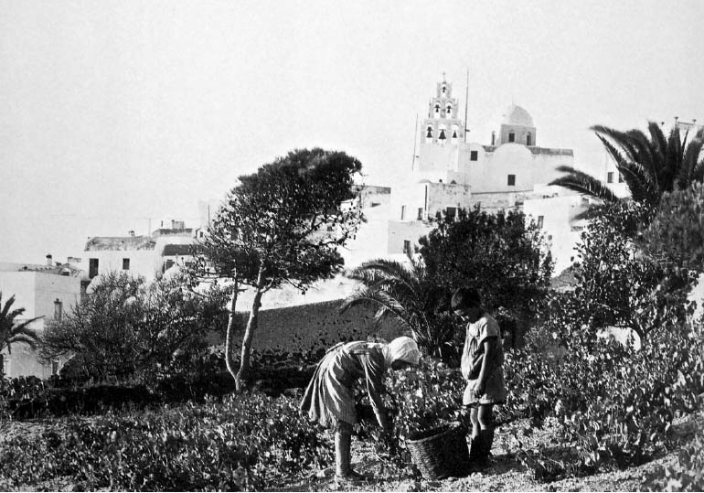
Santorini’s tomato & the Bolsheviks
During the Bolshevic Revolution, most of the churches of Russia were closed down.
In those days the Russian priests were very fond of Vinsanto wine, which incidentally was also produced in Santorini.
Since the demand for Vinsanto wine declined, it was the turn of Santorini tomatoes to draw the attention of the Russians.
Karamolegkos vinsanto winery

Slide 4
20th century
Earthquake
The devastating earthquake of 1956 forced the industries to either close down their factories or move to other regions of Greece.
Tourism
Another heavy blow to the tomato industry came when tourism became a more lucrative venture for most Santorinians.

Slide 5
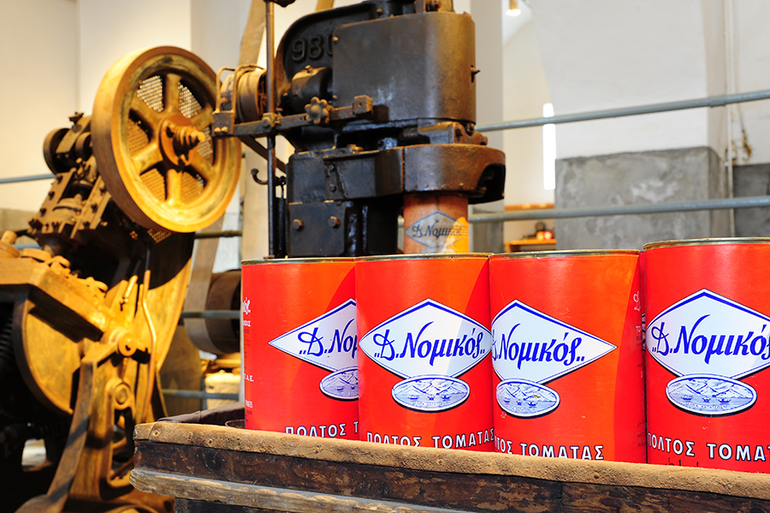
19th Century
The Nomikos business family history starts in the middle of the 19th century since Dimitris Nomikos initiated the construction of “Fabrika”, the first motorised flour mill in Fira.
“Fabrica” is one of the most important part of the history of Fira.
In the same area Dimitris Nomikos set up a distillery, a pasta factory and a bakery.

Slide 6
Timeline
The factory of Vlychada is tranformed into the Tomato Industrial Museum,
“D. Nomikos” and a wider cultural space called the Santorini Arts Factory (SAF).
Dimitrios Nomikos starts producing tomato paste using pre-industrial technology in Messaria, Santorini.
George Nomikos builds the factory at Vlychada, in the centre of the most productive tomato area in Santorini. The factory operates the first season without even a roof.
Tourism will grow rapidly while tomato cultivation will shrink dramatically on the island, forcing the factory to close permanently.
1915
1922
1945
1952
1981
1982
2014
In the winter of 1952, during a rainstorm, a flood breaks the door of the large courtyard, enters the factory and carries away products and machinery into the sea.
This year “D. Nomikos” will operate its new factory at Domokos, Fthiotida, along with Aliartos.
One of the first factories for the production of canned tomato products was built at Monolithos.

Slide 7
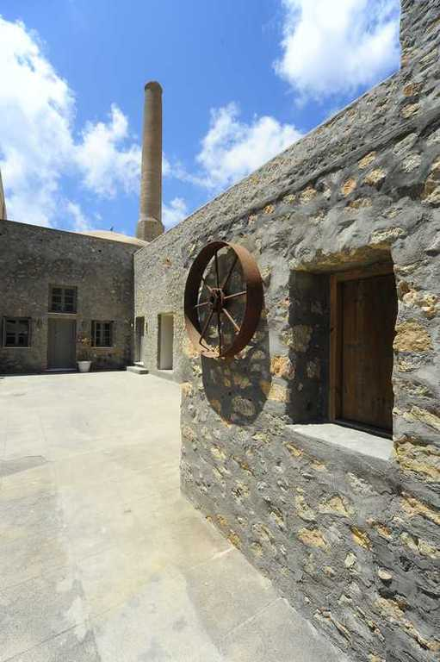
The Museum
The old tomato factory D. Nomikos in Vlychada was transformed in 2014 into a modern Industrial Museum.
Narrates stories about time, memories and the inhabitants of the island.
Follows the procedure of cultivation, processing and production of small-fruited tomatoes.

Slide 8
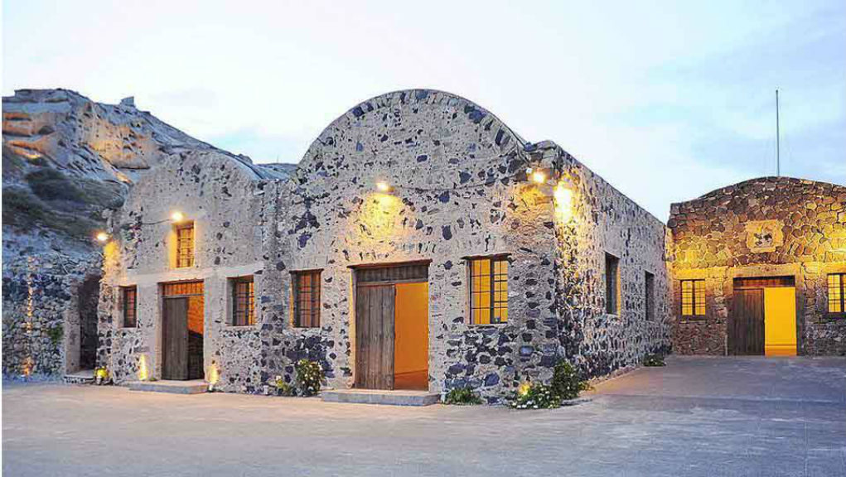
Santorini Arts Factory
Santorini Arts Factory, created and integrated in a historical place – the old tomato factory – contributes to the highlighting of the industrial history of the island and its inhabitants.

Slide 9
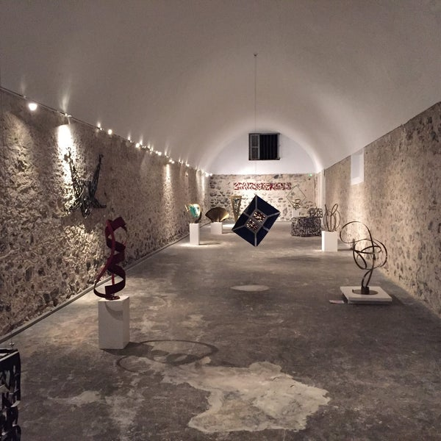
Arts Factory offers art events, such as music, theater and dance performances, as well as art exhibitions, which take place throughout the year and mostly during the summer period.

