Slide 1
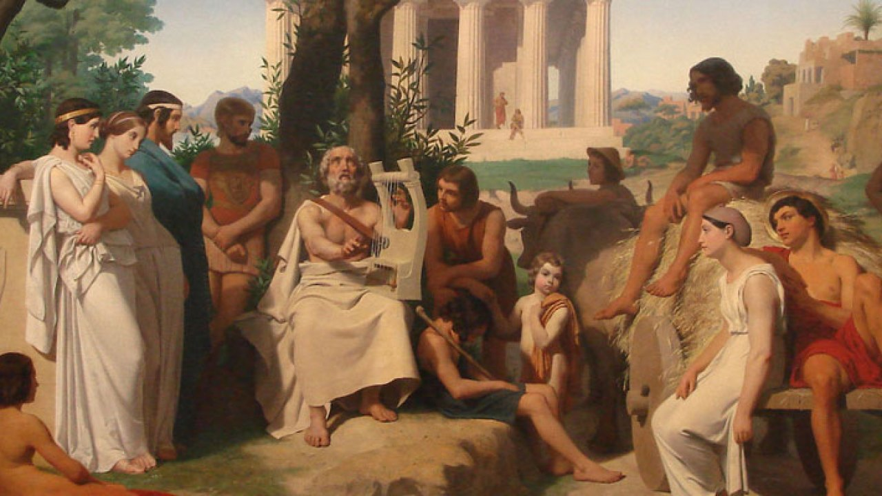
Ancient Greek Literature and Poetry Αn original presentation prepared by the HELLENIC CULTURE CENTRE VIP Project EU 18

Slide 2
Ancient Greek literature
Ancient Greek literature had four major writings; epic traditions, lyric poetry, tragedy and comedy.
An example of the epic traditions are the Iliad and the Odyssey.
Lyric poems got its name from a group of individuals singing while playing the lyre.
Tragedies and comedies were dramas and used to honour Greek god Dionysus.

Slide 3
Homer
Homer & Epic Poetry Wrote two great epic poems The Iliad and The Odyssey ILIAD – tells the story of Achilles in the final days of the Trojan War ODYSSEY – tells the story of Odysseus and the challenges he faced on his ten-year journey home after the Trojan War These stories were not just entertaining, but central to Greek education system.
You are even likely to read these in high school or college!

Slide 4
Greek Tragic Poets
The most important of the tragedians, according to the ancient critics, were:--
A. Thespis, the father of tragedy;
B. The three great poets
1. Aeschylus, 2. Sophocles,
3. Euripides

Slide 5
Have you heard and read Greek?
Η Σελήνη έδυσε και η Πούλια·
είναι μεσάνυχτα, η ώρα περνά, κι εγώ κοιμάμαι μόνη.

