Slide 1
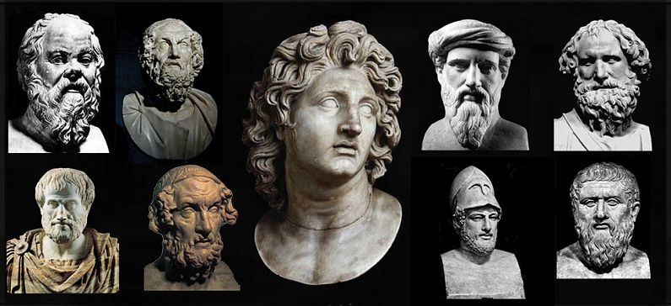
Greek Historical Figures
Αn original presentation prepared by the HELLENIC CULTURE CENTRE VIP Project EU
26

Slide 2
Alexander the Great
Alexander the Great is the most famous Greek personality ever. His short life was full of adventures.
Born in Pella, Macedonia, in 356 BC, he became king at the age of 20.
After he united the Greek city-states, he launched an expedition to the East and managed to conquer the Persian Empire and extend the borders of his kingdom till India.
He died a month before he turned 33, beloved as a god while he was alive and celebrated as a legend after his death.

Slide 3
Homer, the Epic Poet
Homer, the famous poet of the Greek antiquity, is known all over the world for his two epic poems, the Iliad and the Odyssey.
Historians believe that Homer was blind, as shown by his name, which in Greek means "he who can't see".
Many cities claim to be the birthplace of Homer, while it is believed that he died in Ios, the homeland of his mother.
He lived in the 8th century BC and didn't actually write his poems, but narrated them and scholars wrote them down.

Slide 4
Socrates, the Enigmatic Philosopher
Socrates is considered today as the founder of Western philosophy. His notions of ethics, virtue and truth passed through centuries.
Although we have no manuscipts of Socrates himself, his life and ideology are vividly presented in the works of Plato and Xenophon, his direct students, while some accounts are also found in Aristotle and Aristophanes.
Socrates believed that the real truth is hidden in every man and all he has to do is to discover it.
Because of his philosophical teachings, he was accused of corrupting the youth and was sentenced to death by the Athenian politicians.
He died in prison drinking poison.

Slide 5
Plato, the Metaphysic Philosopher
Plato (428-358 BC) is one of the three most famous Athenian philosophers.
Student of Socrates and teacher of Aristotle, Plato is the most vague of the classical thinkers.
His theories were much innovative for his time.
Plato introduced a new political system, where philosophers, as the holders of real truth and knowledge, would rule.
An opponent of democracy, Plato thinks that ruling a state must not be based on persuasion but on wisdom.
Giving his theories a metaphysical aspect, Plato believed that two parallel worlds exist, the real world and the world we live in, which is a reflection of the real world.

Slide 6
Aristotle, the Philosopher of Reason
Aristotle, student of Socrates and Plato, is the third most famous philosopher of the Greek antiquity.
He studied in the Academy of Plato, the first university of the world.
When Plato died, he went to teach the son of king Phillip of Macedon, Alexander the Great.
On his return to Athens, he founded Lyceum, a school of philosophy and other sciences.
Although only one third of his work survives today, it can be seen that he studied almost all sciences known in the ancient times.
His philosophical notions survived for centuries and influenced a lot the Western culture.

