Slide 1
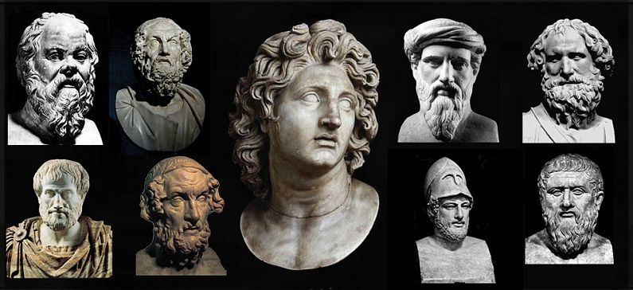
Greek Historical Figures
Αn original presentation prepared by the HELLENIC CULTURE CENTRE VIP Project EU
26

Slide 2
Pericles, the Inspired Statesman
Pericles (495-429 BC) was the man who led Athens to its glory.
An inspired politician, a brave general and a persuasive orator, Pericles led his hometown to the top scale.
It was under his guidance that Athens became the greatest naval power all over Greece, that the Acropolis was built and that culture was developed.
Born in 495 BC, he took part in many battles and remained leader of the town for 40 years.
After his death, Athens lost his power and never managed to recover from this loss.

Slide 3
Leonidas, the legendary King of Sparta
Leonidas, the legendary king of Sparta, is world famous for his act of self-sacrifice, when he and his 300 Spartan soldiers died in the battle of Thermopylae to protect the rest of Greece from the Persian invasion, in 480 BC.
Today, the statue of Leonidas lies at the site of Thermopylae to commemorate this special event.
The tomb of the king is found in Sparta, his homeland, where he was honored as a god till the Roman times.

Slide 4
Solon, the Athenian Lawmaker
Solon (638-558 BC) was an Athenian politician, lawmaker and poet.
He came into power in a time when the society of Athens was facing serious social problems and his reforms were crucial for the creation of a new governmental system that would make the fate of the town, democracy.
He actually gave political rights to common citizens, not only the noblemen, and enforced trade as the main economic source of the town.
Although his political measures lasted for short, Solon had already set the ground for the development of the town which came with Pericles about half a century later.

Slide 5
Hippocrates, the Physician
Hippocrates (460-377 BC) is the most famous physician of ancient Greece.
Developing very innovative theories and practices for his time, he combined medical observation and philosophy to cure illnesses.
Hippocrates believed that the human body has the power to heal itself.
He said that all is a matter of balance between the four elements of the body: blood, black bile, yellow bile and phlegm.
People get ill in case this balance is interrupted. To restore this balance, he didn't use drugs, except for natural extracts and soothing balms.

Slide 6
El Greco, the painter
His real name was Domenicos Theotokopoulos, however he became famous as "El Greco" (The Greek).
When he was born, Crete was under Venetian Occupation. A
t the age of 26, he moved to Italy, opened a workshop and spent several years there.
In 1577, he moved to Toledo Spain, where he stayed till his death.
Regarded as a precursor of Expressionism and Cubism by modern critics, the paintings of El Greco were mostly inspired by religion. He also made many famous portraits.
El Greco died in 1614 and was buried in the Church of Santo Domingo El Antigua, in Toledo.

Slide 7
Nikos Kazantzakis
Nikos Kazantzakis (1883-1957) is the most translated Greek novelist of the 20th century.
Born in Heraklion Crete, Kazantzakis studied law in Athens and philosophy in Paris.
His work as correspondent gave him the chance to travel in most countries of the world.
His book The Last Temptation of Christ (1950), where Kazantzakis shares his metaphysical and existential concerns, was prohibited by the Roman Catholic Church.
When he died, the Orthodox Church didn't allow him to be buried in a cemetery, which is why his tomb lies outside the walls of Heraklion. Following his will, his epitaph reads I hope for nothing. I fear nothing. I am free.

Slide 8
Constantine Cavafy, the Poet
Constantine Cavafy (1863-1933) is one of the most famous Greek poets worldwide.
Born in Alexandria Egypt to Greek parents, he managed to distinguish with his sensitive and liberal style of writing. His poems are inspired by philosophy, mythology and history, while he frequently expresses personal experience in his works.
His work was often a base to express his homosexuality, which was a taboo for his time.
Irony is a common feeling in his poems, while he didn't keep the structural forms of his time, such as rhyme.
The best known poem of Cavafy is Ithaca, a philosophical poem based on the journey back home of Ulysses.

Slide 9
Maria Callas
She is mostly called La Divina and she has been awarded as the greatest opera singer in the world.
Maria Callas was born in 1923 in New York to Greek parents. In 1937, her family moved to Athens and she attended music courses in the Conservatory of Athens. Soon, her teachers appreciated her warm and heavy voice.
After some performances in the Greek National Opera, she moved to Italy and started to perform in La Scala di Milan.
Her career reached its peak in the 1950s and then it decreased, either from a vocal decline or because she wanted to focus on her personal life, which was marked by an unlucky marriage, a devastating affair to Greek ship owner Aristotle Onassis and loneliness.

